Slide 1
Milestone 1
June, Wen Hui, Hui Ting

Slide 2
Table of Content
Introduction of Graph
Graph 1 - Problems
Introduction of Graph 2
Graph 2 - Problems
Graph 1 - Solution
Graph 1 - Solution 2
Graph 2 - Solution

Slide 3
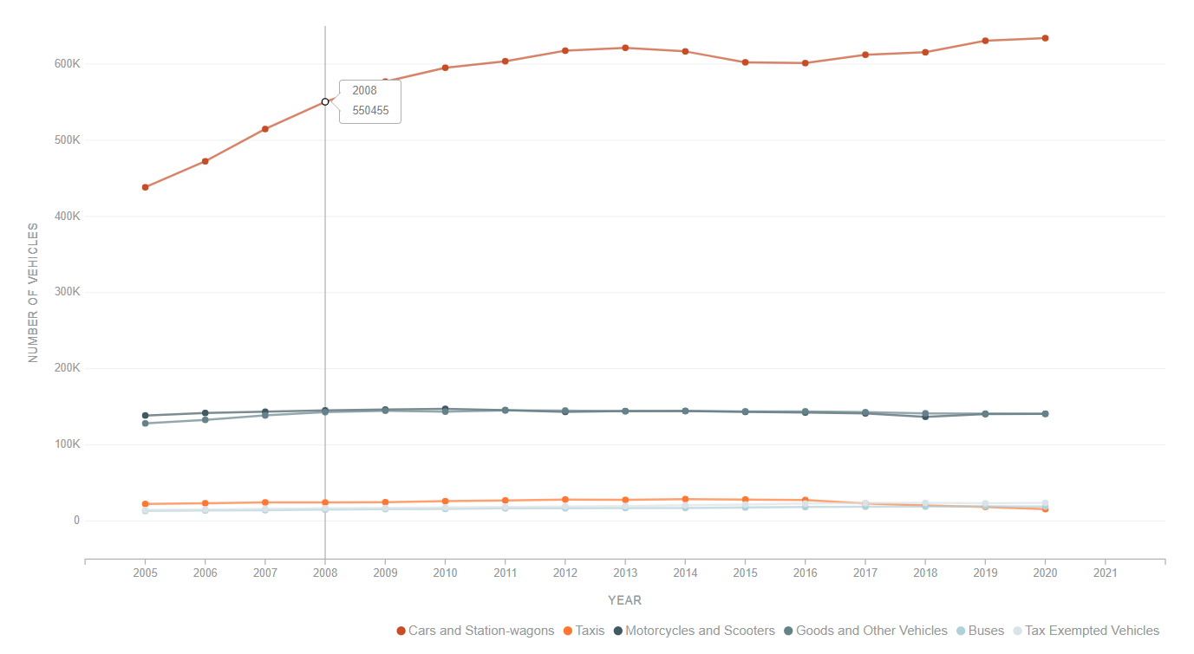
Introduction of Graph 1
Annual Motor Vehicle Population by Vehicle Type
Represents the growth in the number of different vehicles over the years in Singapore.
Created from dataset collated by SG government from January 2005 to December 2020.
The categories covered in this graph includes:
Cars and station wagons
Taxis
Motorcycles and Scooters
Goods and other vehicles
Buses
Tax Exempted Vehicles

Slide 4
Graph 1 - Problems
Annual Motor Vehicle Population by Vehicle Type
Unsure what kind of data to focus on (what is actually trying to tell)
Not much interactivity for the users
Does not have a clear message for user.
Bad Accuracy Perception: The chart only showed growth in cars and station wagons, while other vehicles seem to remain the same, but this is false.
Color Scale: The choice of color mixed some of the scales together, making it almost indifferentiable. (The colors of negligible contrast)
Notes:
Can resolve with animation, transition and filter. (Toggle interactive filter)
Line charts

Slide 5
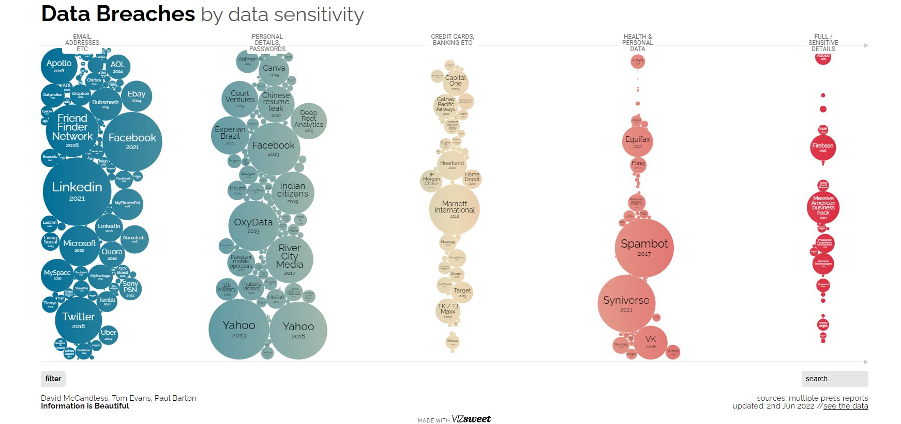
Introduction of Graph 2
Security Data Breaches by data sensitivity
Data
Data Breach
Task
Display the different data breaches based on sensitivity
Idiom
Interactivity bubble charts
Notes:
Thank you, June, Now I will be talking about the interactivity bubble chart on security data breaches.
The charts display the different types of companies with a circle size shape to represent the amount of data loss.When hover over,, it will expand the shape to display more details on the incidents and year taken place.
The chart is categorized based on the different types of data breaches that take place. The data used is based on a collection of incidents reported throughout the year on data breaches happening.
The categories of breaches include data leakage such as
Email addresses
Personal details & Passwords
Credit Cards, Banking
Health & Personal Data
Full / Sensitive Details

Slide 6
Introduction of Graph 2
Security Data Breaches by data sensitivity
Display different type of data breaches
Based on amount of data loss
Company
Accumulation of all the data breach
incidents reported in the news over the years.
The categories covered in this graph includes:
Email addresses
Personal details & Passwords
Credit Cards , Banking
Health & Personal Data
Full / Sensitive Details
Notes:
Thank you, June, Now I will be talking about the interactivity bubble chart on security data breaches.
The charts display the different types of companies with a circle size shape to represent the amount of data loss.When hover over,, it will expand the shape to display more details on the incidents and year taken place.
The chart is categorized based on the different types of data breaches that take place. The data used is based on a collection of incidents reported throughout the year on data breaches happening.
The categories of breaches include data leakage such as
Email addresses
Personal details & Passwords
Credit Cards, Banking
Health & Personal Data
Full / Sensitive Details

Slide 7
Introduction of Graph 2
Security Data Breaches by data sensitivity
Display different type of data breaches
Based on amount of data loss
Company
Accumulation of all the data breach
incidents reported in the news over the years.
The categories covered in this graph includes:
Email addresses
Personal details & Passwords
Credit Cards , Banking
Health & Personal Data
Full / Sensitive Details
Notes:
Thank you, June, Now I will be talking about the interactivity bubble chart on security data breaches.
The charts display the different types of companies with a circle size shape to represent the amount of data loss.When hover over,, it will expand the shape to display more details on the incidents and year taken place.
The chart is categorized based on the different types of data breaches that take place. The data used is based on a collection of incidents reported throughout the year on data breaches happening.
The categories of breaches include data leakage such as
Email addresses
Personal details & Passwords
Credit Cards, Banking
Health & Personal Data
Full / Sensitive Details

Slide 8
Graph 2 - Problems
Unclear xScale and yScale
Difficult for the viewer to comprehend (Too many variables)
No clear accurate value to show the severity of visual on severity
Due to the smaller circle are almost invisible
No value is displayed
Misleading representation
Circle size does not represent impact of the value of the data
Example : Smaller value within the graphic represented as small circle but compare to real life value ( the amount of data loss) may equal to a few countries cities.
Color Scale (Color Disproportionates)
Intensity of the colors does not represent the severity
Example : the transition from the brighter blue and green to pale yellow
Color selection does not represent the severity of the category
Security Data Breaches by data sensitivity
Notes:
Moving on to the problems in graph 2, Firstly the usage of Xscale and Yscale there is no clear indication of what variables are used in the graph making it hard for viewers to comprehend the graph at first glance.
Without actual values display It is hard for the viewer to estimate the different circle sizes when they are similar and certain circles are even too small to be visually able.
The second point is misleading representation. The circle size does not represent the severity of the data breach compared to real-life scene values and does not represent the impact of the larger amount value of the data breach that took place.
Lastly, colour scale, the colour scale caused the intensity of the colour disproportionate as it does not representant the severity of the data breach amount or severity of the category of the data breach.
https://informationisbeautiful.net/visualizations/worlds-biggest-data-breaches-hacks/#bysensitivity

Slide 9
Graph 1 - Solution
Bar Graph - Show vehicle trend throughout the years clearly
Use highlight or animate to focus on the bar graph (User interactivity)
Have a clear display of the different gap between each lines: Can be clear labelling or tooltips to display more information
Change colors of both “Motorcycles and Scooters” and “Goods and Other Vehicles” so that they can be easily differentiated.

Slide 10
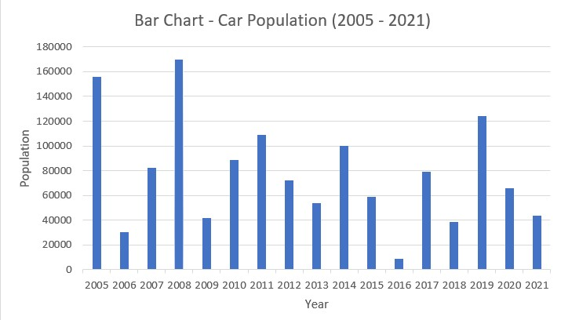
Graph 1 Solution - Bar Graph (By Category)
Total of 6 car categories showcased in the line graph showed little due to large value differences across the categories.
Differentiating these data across 6 bar graphs - Allows the change in the number of vehicles across the years for each category to be more prominent.
The tooltips will also aid in providing the user more information regarding the amount of vehicles for that year.
Notes:
Thank you Wen Hui
What
Bar graph show a vehicle amount across years
Option to see different number of vehicle across years
Why
Previous line graph -> can’t show trend properly, overlapping lines
Show trend of a vehicle population over the years clearly
tooltip -> amount of vehicles

Slide 11
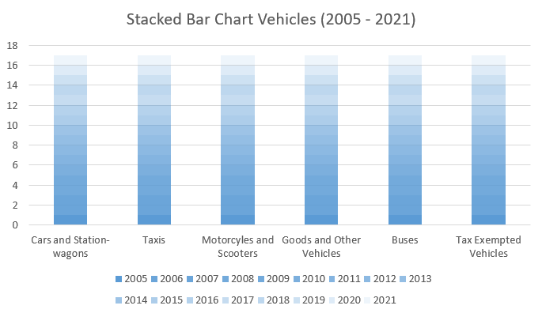
Graph 1 Solution - Stacked BarChart (Comparison)
Clearly showcases the growth of the number of vehicles across the years for each category. E.g. stagnant increase vs obvious upward trend.
Allows for more prominent comparison across the categories, such as the difference between each category.
Tooltip: Number of vehicles each year
Notes:
What
Bars showing each vehicle category
Each stacked portion -> amount in that year
Why
Compare growth of different vehicles across years clearly
Compare overall amount of vehicles

Slide 12
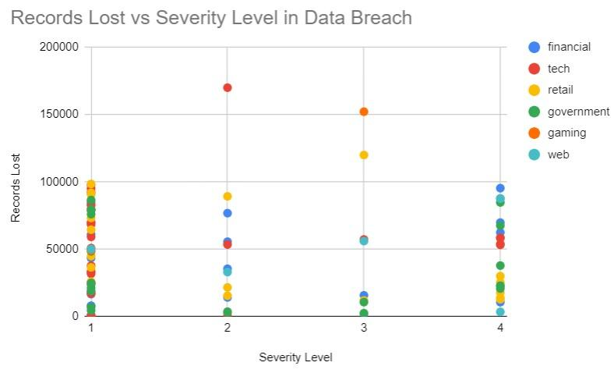
Graph 2 Solution - Scatter Plot
X- axis: Priority Level - email addresses, personal addresses and passwords)
Y-axis: Impact - The amount of data records lost
Color code: sector affected - Group to a small number of colors
Hover Tooltip: Information - Company and year
Clearly show which sector and company has the most severe data breach
Notes:
What:
Scatter plot
X axis -> severity level => what is breached
Y axis -> number of records lost
Color coded as sectors of companies affected
Tooltip: company and year
Why
Reduce clutter in graph - Many data points in original data
Large circles won’t overcrowd the page => smaller points hard to see
Differentiate big data breaches from others (use distance from other data points, than size)
See overall trend of data breaches - If most points are below a severity level or records lost

Slide 13
Thank you

